Slide 1
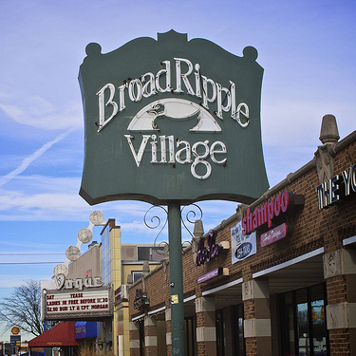
Broad ripple properties
An analysis of 42660

Slide 2

Theme
Visualize and bring to life properties within Broad Ripple from a data perspective using a large data file procured from Indiana State Public Records.

Slide 3

Coding Approach
Secured data
Brainstormed ideas
Settled on html page layout
Determined visualization types
Cleaned the data
Filled in missing information
Divided project

Slide 4
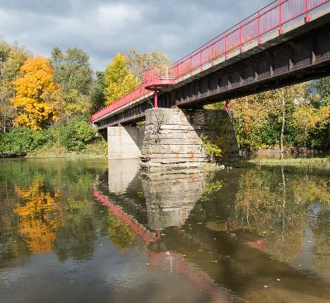
Data Munging Techniques
Reduced file size
Eliminated irrelevant data
Secured coordinates for each property
Merged coordinates with cleaned data

Slide 5
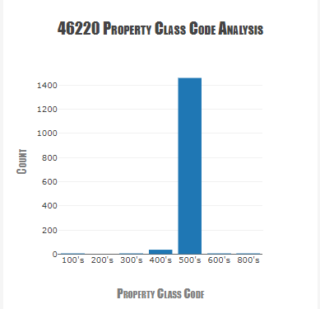
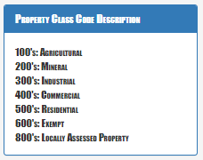
Property code breakdown

Slide 6
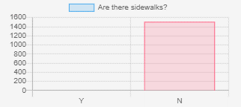
Pedestrian friendly broad ripple

Slide 7
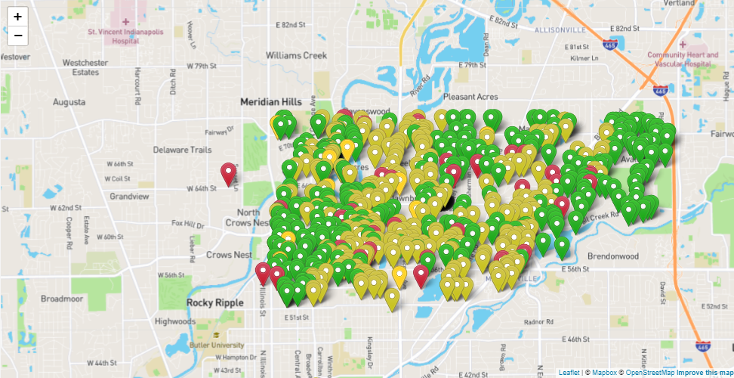
42660 Property listings by value

Slide 8
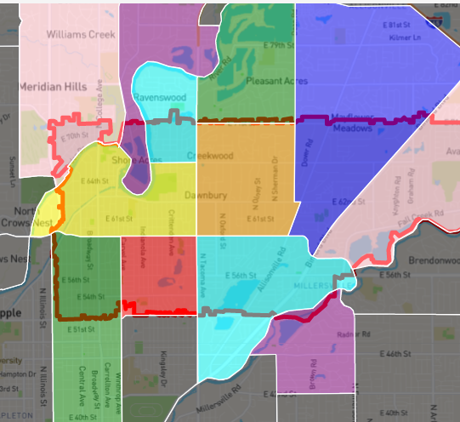
The Neighborhoods of 42660
Broad Ripple
Glendale
Meridian Kessler
Canterbury-Chatard
Allisonville
Devonshire
Millersville
North Central
Meridian Hills/Williams Creek
Ravenswood
Clearwater
I-69/Fall Creek
Devon

Slide 10




Jackson Yaggi
Katie schumann
Data Analyst
Data Analyst
Helena o’farrow
Tim marlett
Nathan prows
Data Analyst
Data Analyst
Senior member of Group two. You can call me Pops.
Data Analyst
10

Slide 11
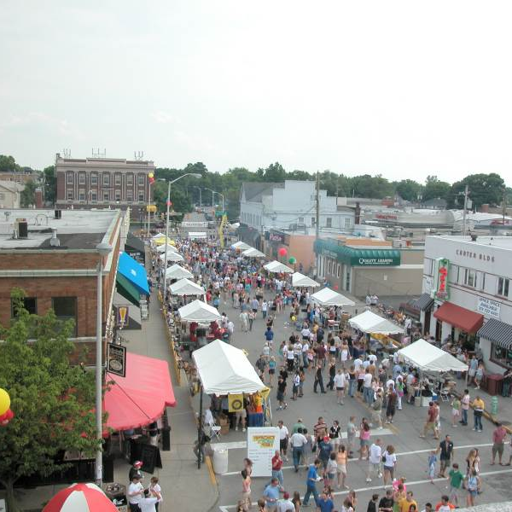
Thank you!
Github link
https://github.com/msckat11/46220-property-analysis

